Slide 1
A Review of The Role of GLOBE Teachers
Joan B. Callope
Philippines
Philippines
22 May 2020

Slide 2
Webinar Objectives
At the end of this Webinar, you should be able to:
Learn how to update country page and teacher profile
Guide GLOBE Teachers on how to create student accounts
Outline the role of GLOBE Teachers

Slide 3
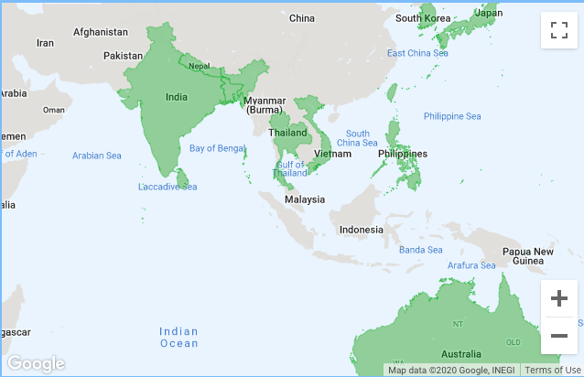
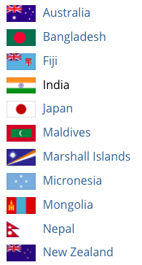
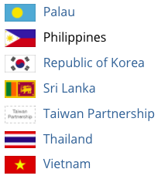
The GLOBE Program, Asia and Pacific
18 Countries

Slide 4
Asia and Pacific, Snapshot
4,842 Schools
4,360 Teachers
634 Pre-Service
64,643 Students
25 Alumni
26,187 GLOBE Observers
676 Trainers
58 Master Trainers
2,036,890 Total Data Entered
222 Student Projects

Slide 5
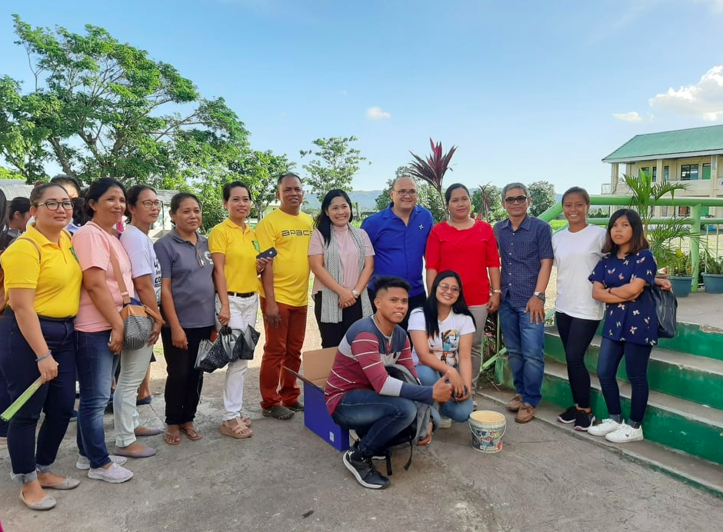
Roles of GLOBE Teachers in the GLOBE Program
In Classroom
-- Implement
GLOBE
In field
– guide students
In Seminar-workshops
– facilitators

Slide 6
How to Encourage Teachers to DO GLOBE
Update the About and Contacts of the Country
Promote the GLOBE Program with emphasis on the benefits and advantage of a GLOBE Teacher
Train them to use the GLOBE Website, its database and other features, including the Observer App.
Teach them how to access and use GLOBE’s teaching and learning materials, and other resources.
Provide them professional development and collaborative opportunities i.e. eTrainings, IVSS, etc.
Train them how to access and use GLOBE Data for research purposes

Slide 7
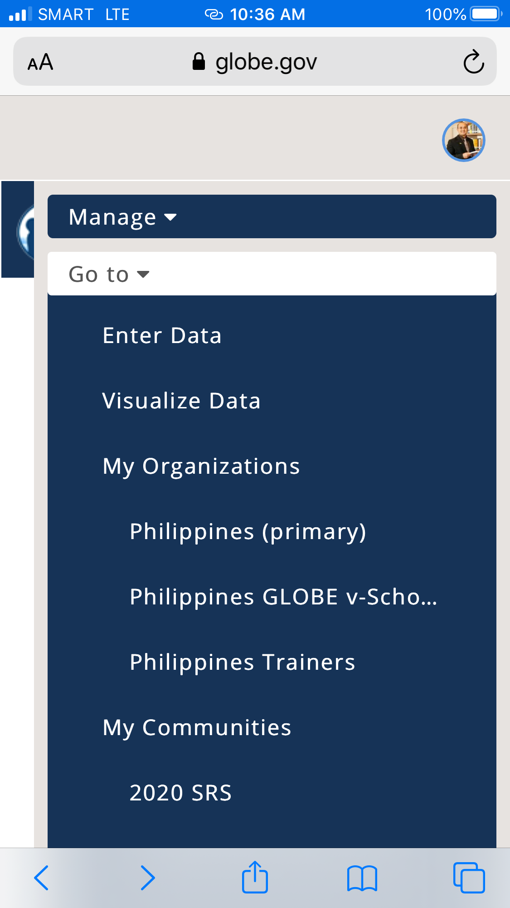
About and Contacts of Each Country
How to Update About and Contacts of the Country
1. Log in to globe.gov
2. Go to Manage

Slide 8
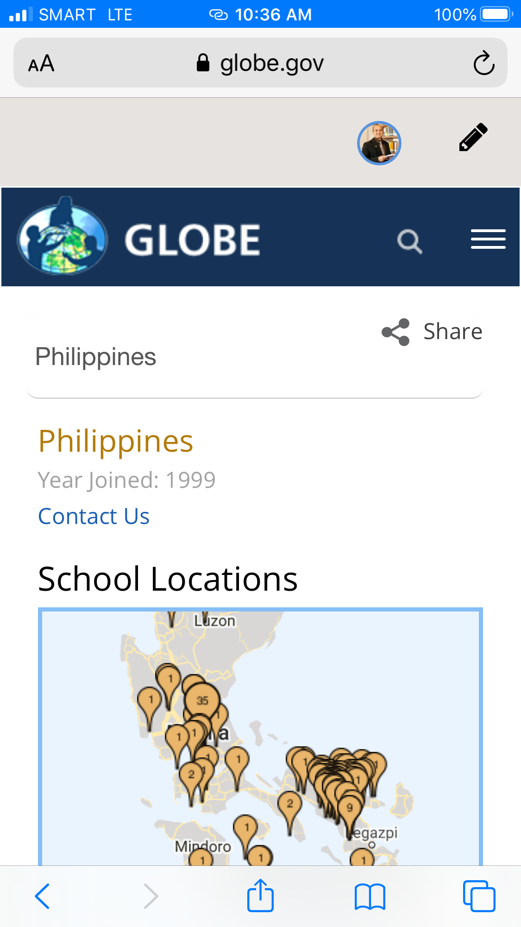
About and Contacts of Each Country
How to Update About and Contacts of the Country
3. Go to My Organization
(click Country)

Slide 9
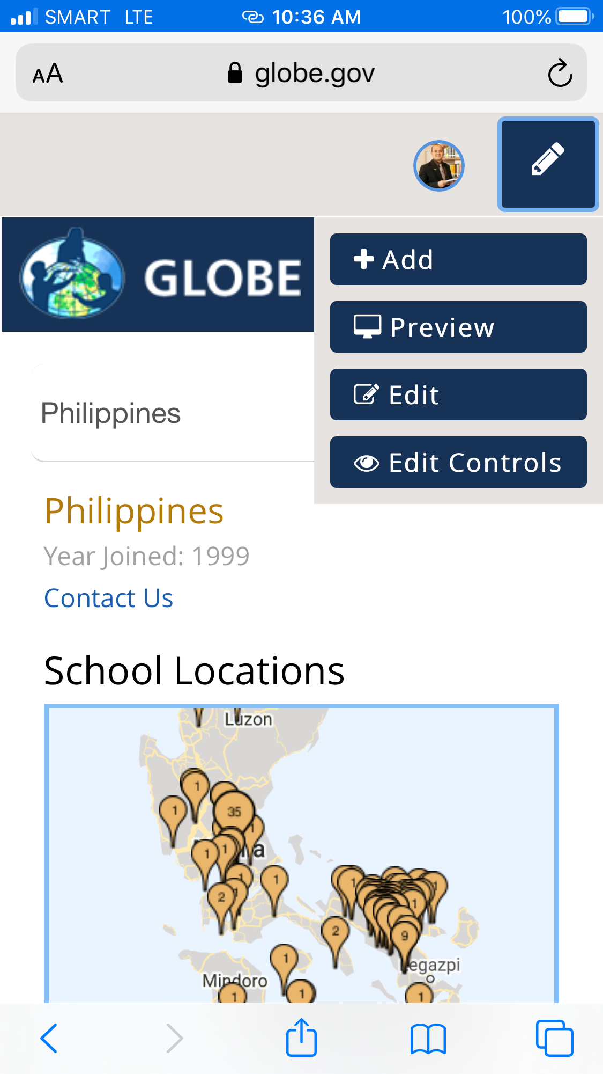
About and Contacts of Each Country
How to Update About and Contacts of the Country
4. Click Edit

Slide 10
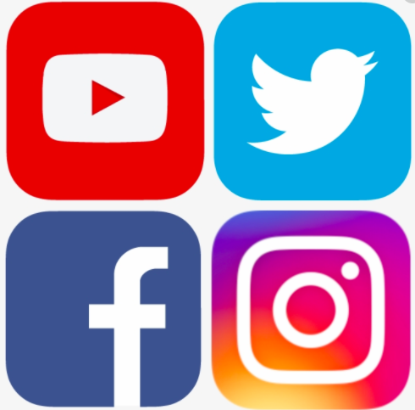
Promotion of GLOBE Program
Sending GLOBE news via email
Use of social media
Conducting webinars

Slide 11
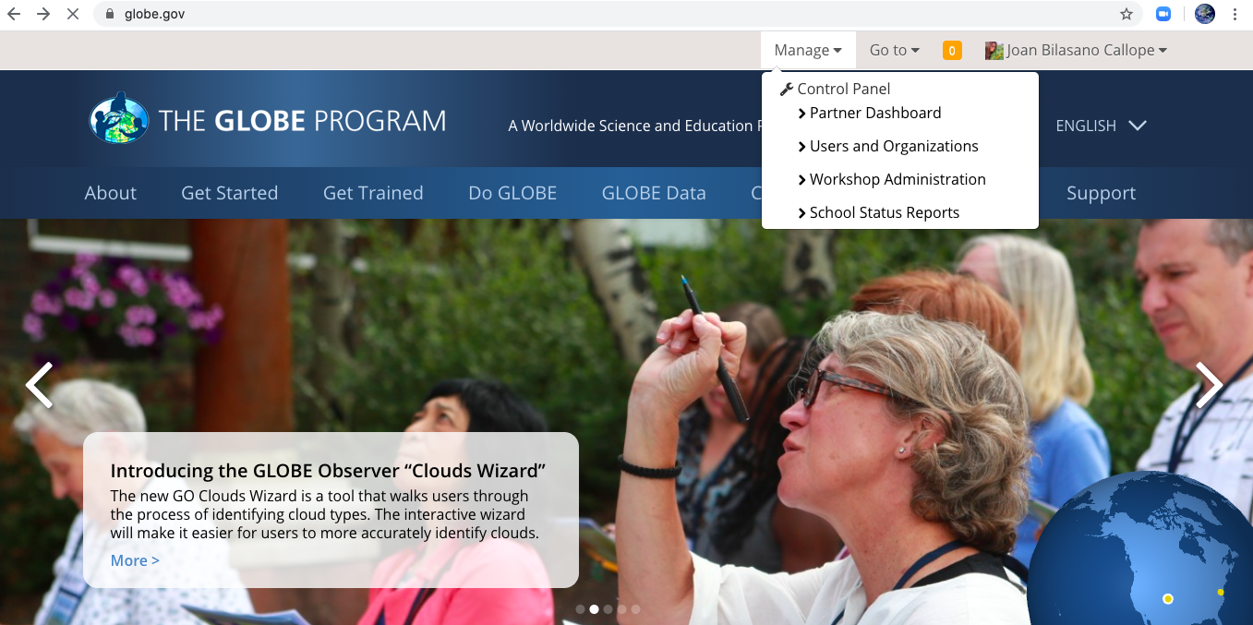
Promotion of GLOBE Program
Sending GLOBE news via email
Use the Workshop Administration Tool

Slide 12
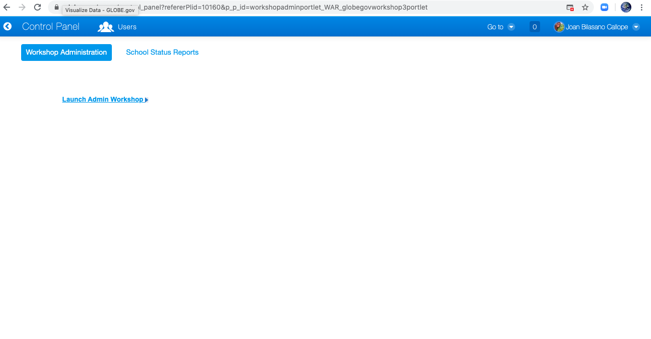
Promotion of GLOBE Program
Sending GLOBE news via email
Click Launch Admin Workshop

Slide 13
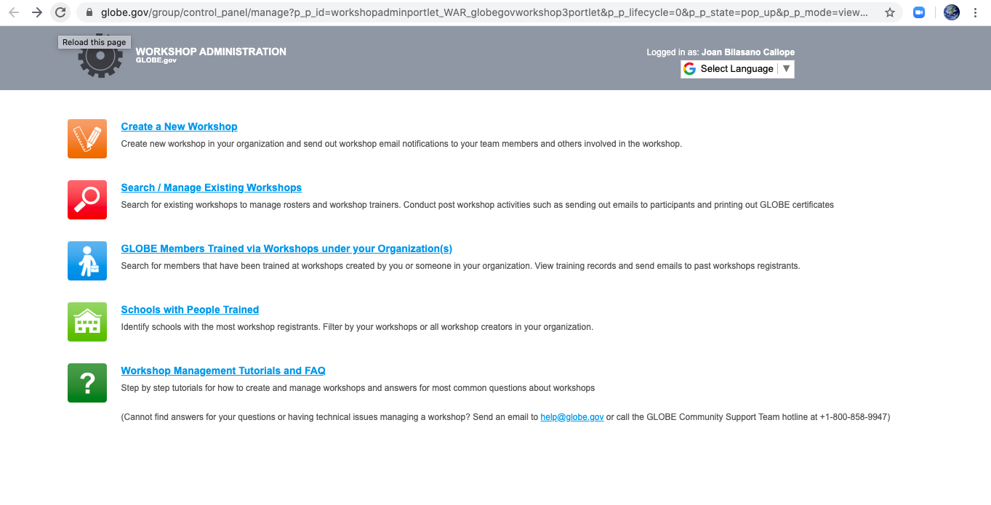
Promotion of GLOBE Program
Sending GLOBE news via email
Search/ Manage Existing Workshop

Slide 14
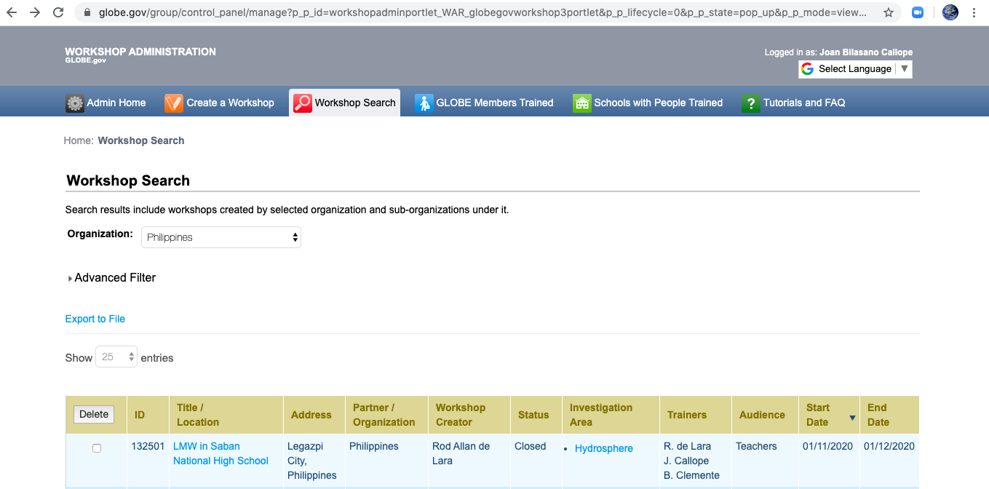
Promotion of GLOBE Program
Sending GLOBE news via email
Click target groups) (Title or location)

Slide 15
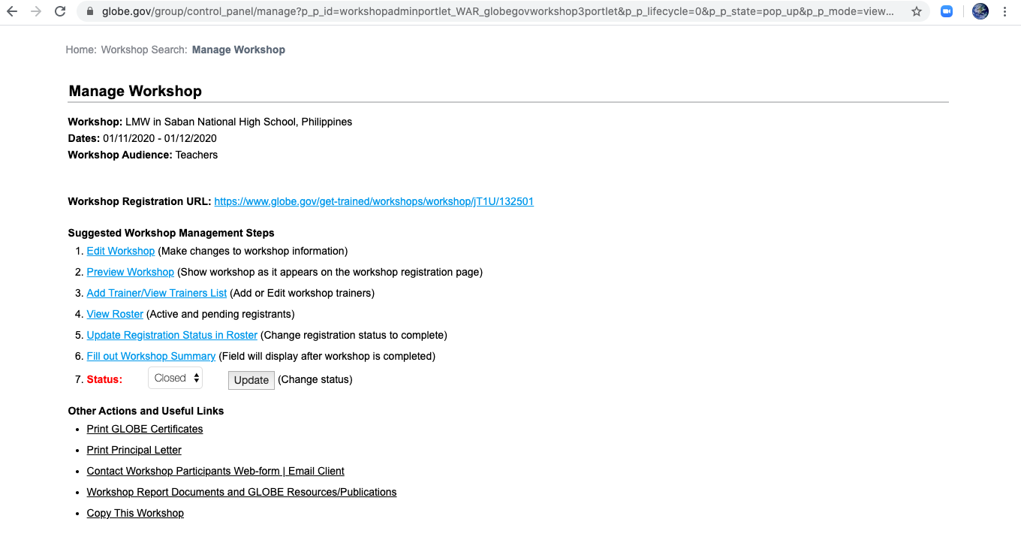
Promotion of GLOBE Program
Sending GLOBE news via email
Click email client

Slide 16
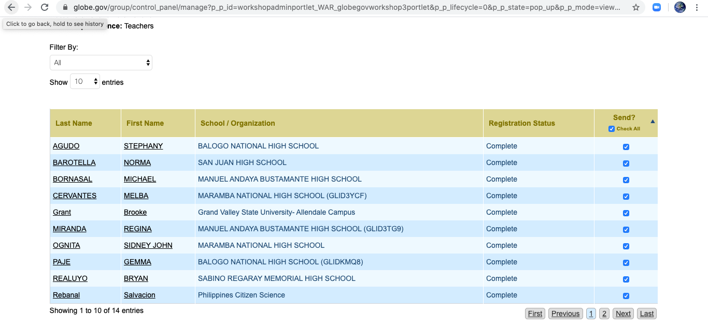
Promotion of GLOBE Program
Sending GLOBE news via email
Click Check all

Slide 17
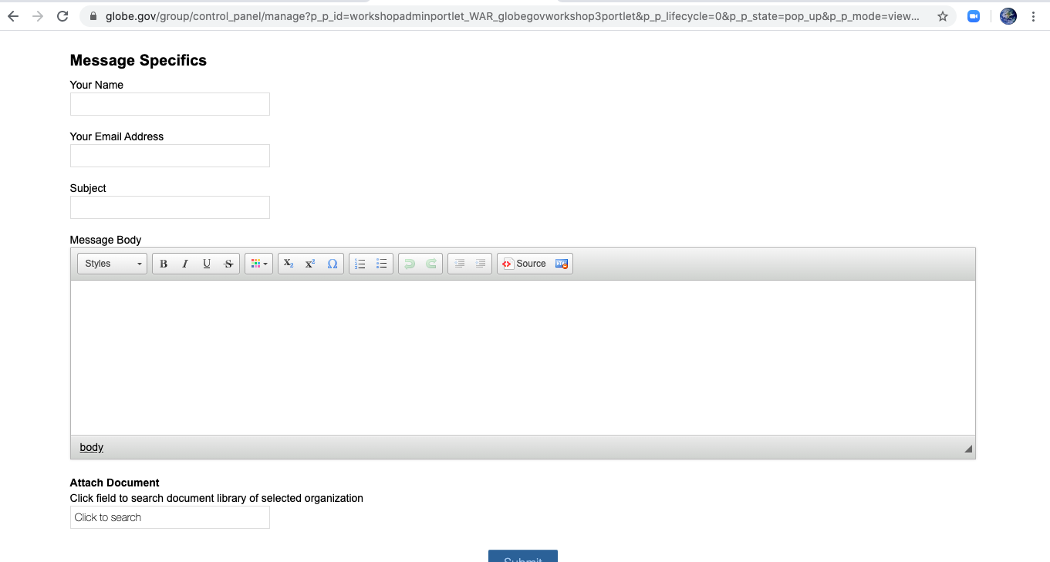
Promotion of GLOBE Program
Sending GLOBE news via email
Email Client web form
Click Submit

Slide 18
How to Create GLOBE Teacher Account
Type globe.gov in the URL
Click Join
Click GLOBE teachers
Click Create a GLOBE Teacher Account and answer boxes (first name, last name, email, gender, country, account type-teacher, Organization Name)
Click Continue
You will see your account summary
Encode your password (follow instruction for password)
Click I am not a robot
Check required boxes
Click Create Account

Slide 19
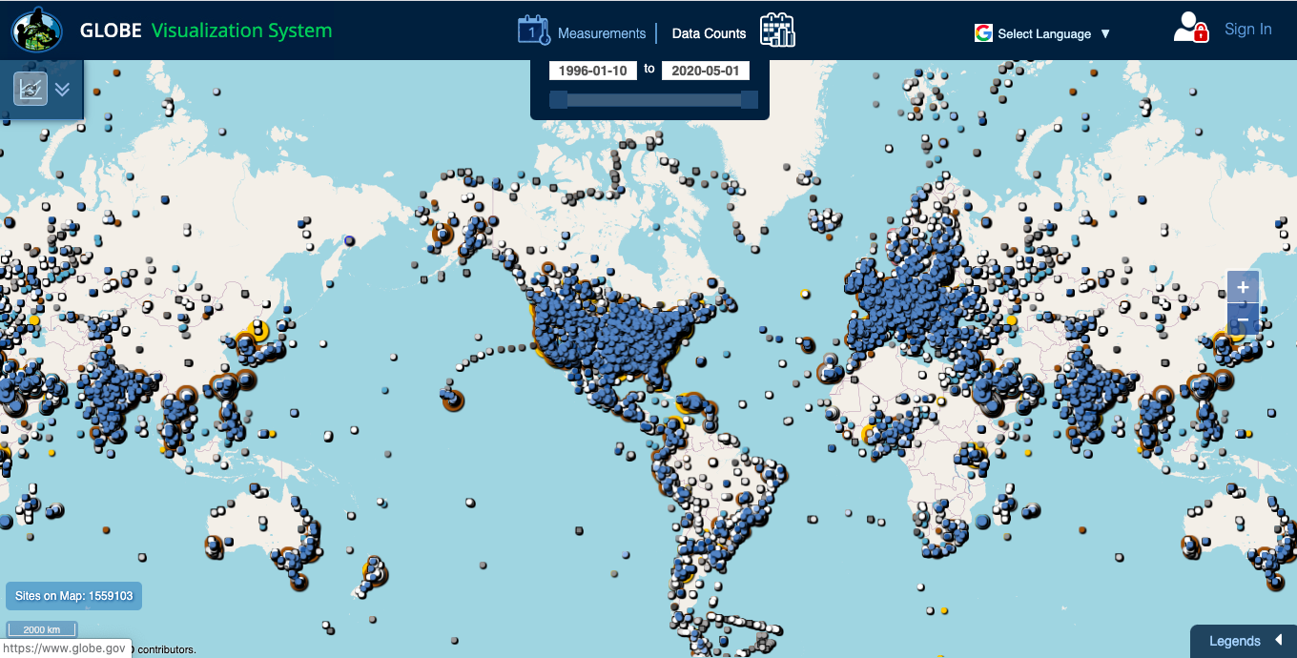
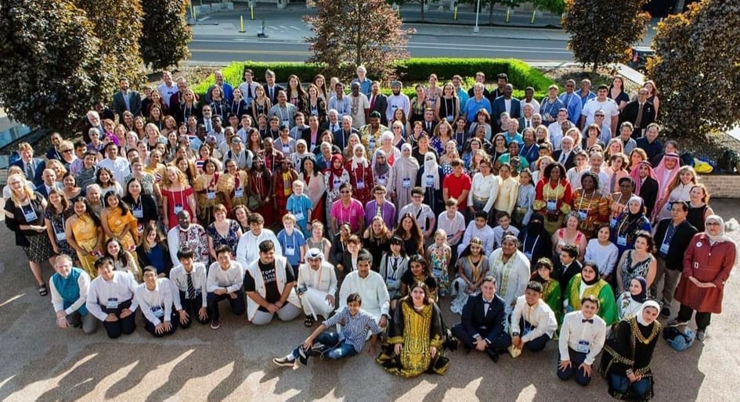
Advantages of Having a GLOBE Teachers Account
Access to updated GLOBE resources and data
Professional growth through GLOBE eTraining
Be a part of GLOBE Community
Notes:
Protocols, Student Research Reports, Elementary GLOBE and Classroom Activities, Research and Resources, GLOBE Observer Website, Measurement Campaigns, Zika Education and Prevention Project, Translated Materials

Slide 20
GLOBE Teacher in Classroom
Create student account
Log in to globe.gov
Click My Page
Click View Student Account
Click new accounts

Slide 21
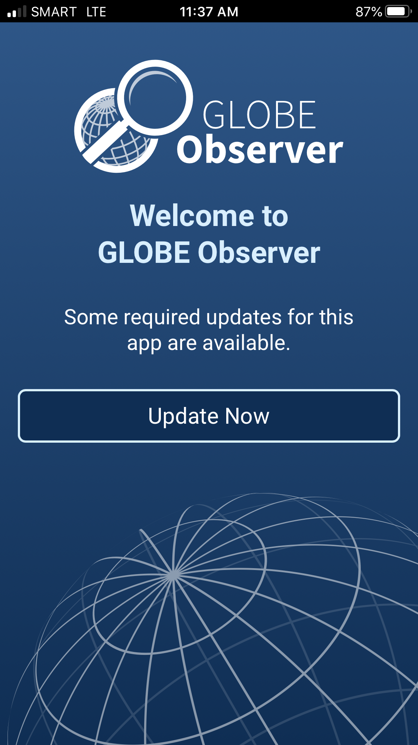
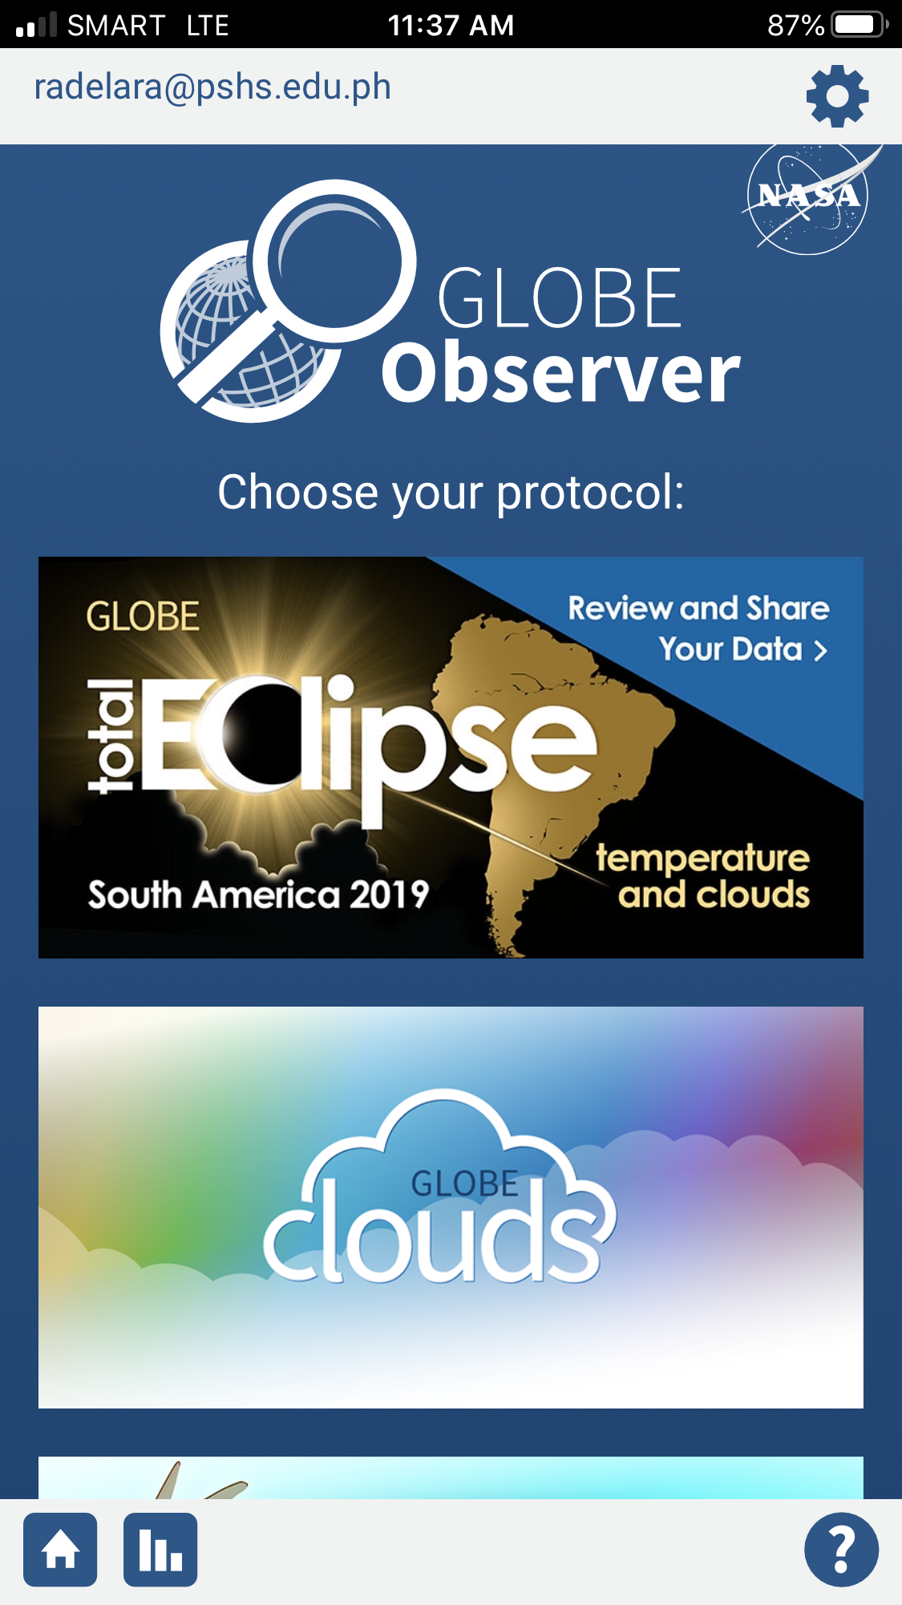
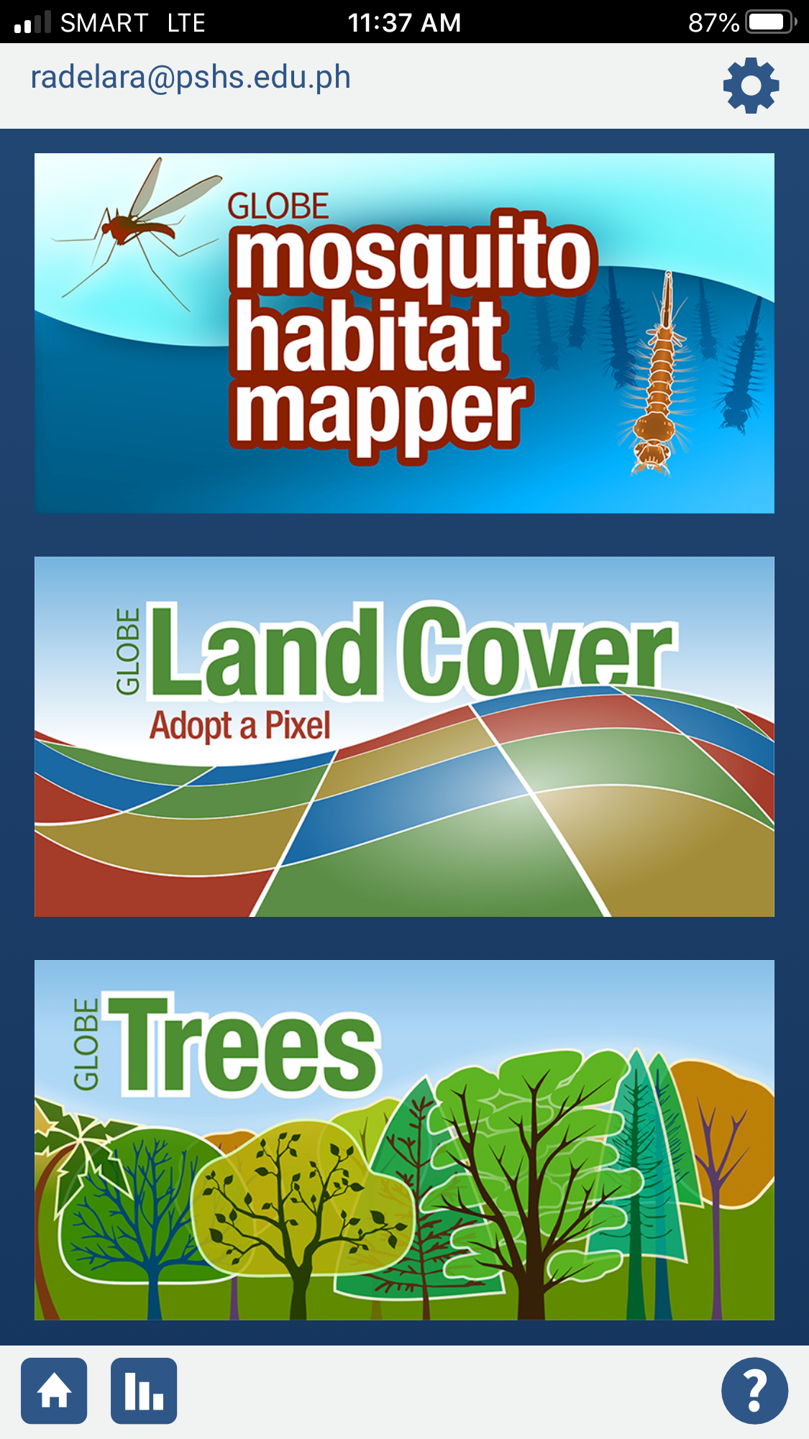
GLOBE Teacher in Classroom
Use of GLOBE Observer App
Download GLOBE Observer App
Log in
Select protocol
Follow directions

Slide 22
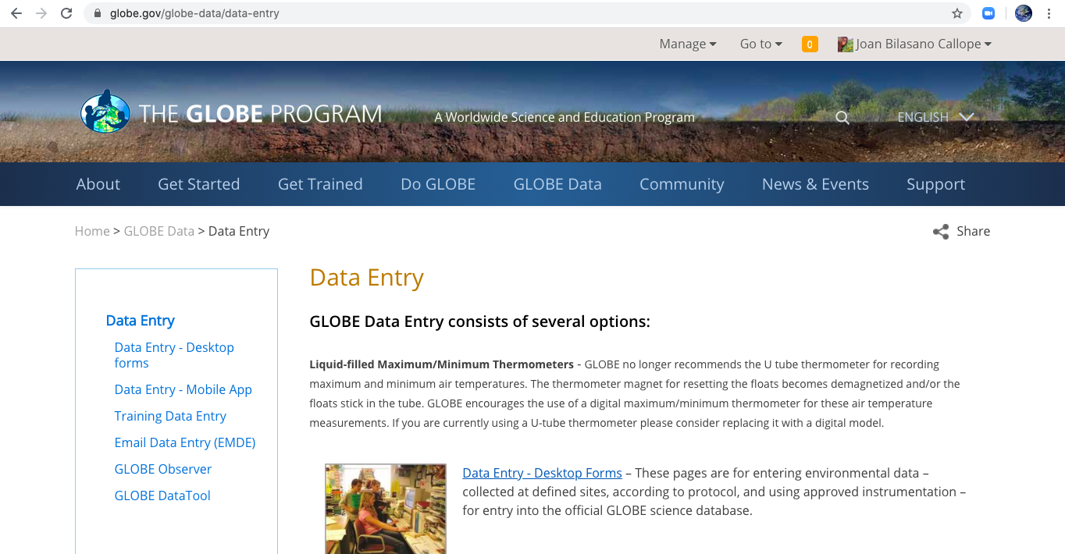
GLOBE Teacher in Classroom
Use of GLOBE Data Entry/Website
Go to GLOBE Data
Click Data Entry-Desktop Forms
Fill in Data

